Slide 1

Neural
Engineering
Team
Week.1
2022.09.16 6pm
Lee Seong Jin

Slide 2
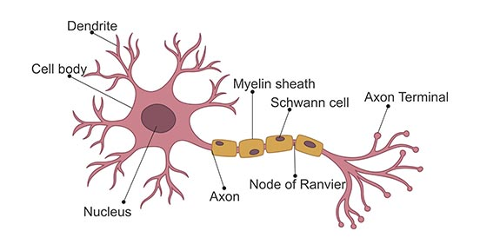
Neuron

Slide 3
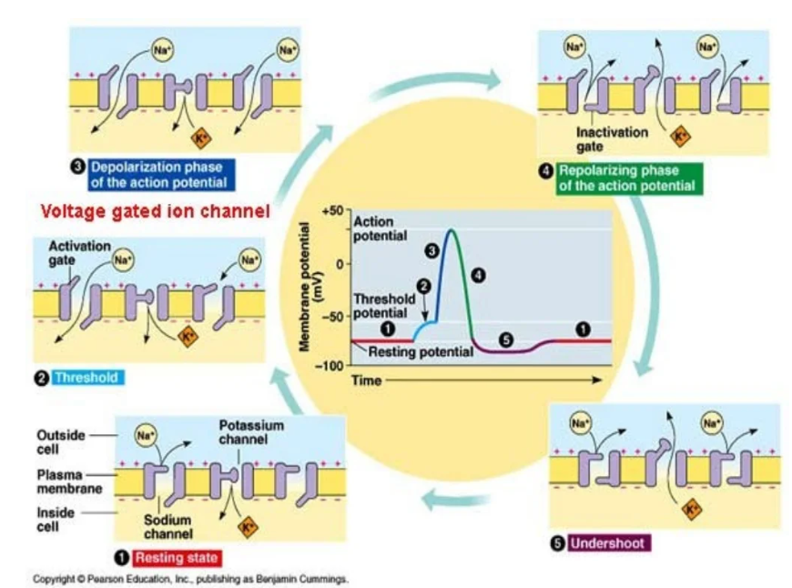
Action Potential

Slide 4
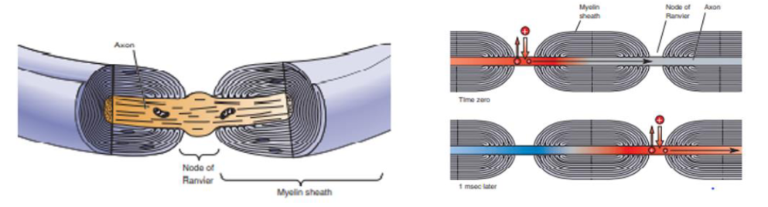
Myelin

Slide 5
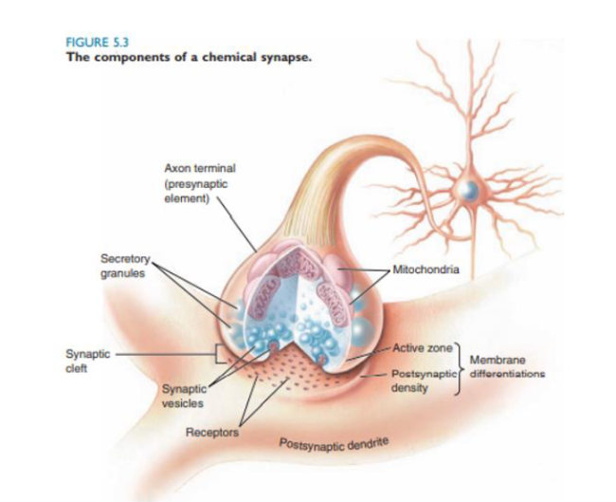
Synaptic Transmission

Slide 6
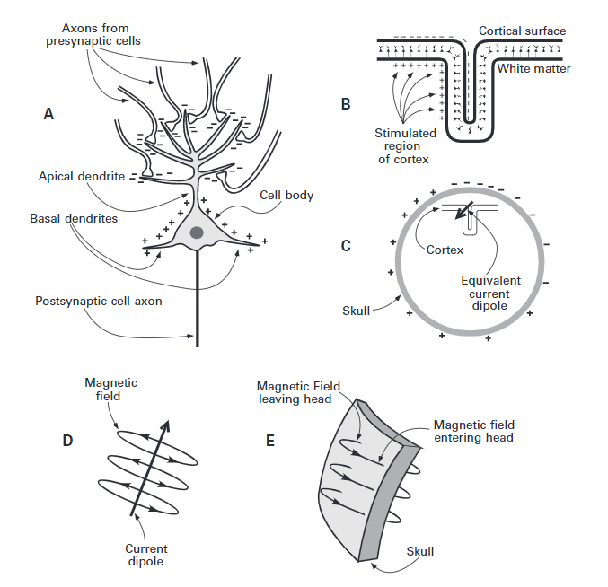
Generation of EEG

Slide 7
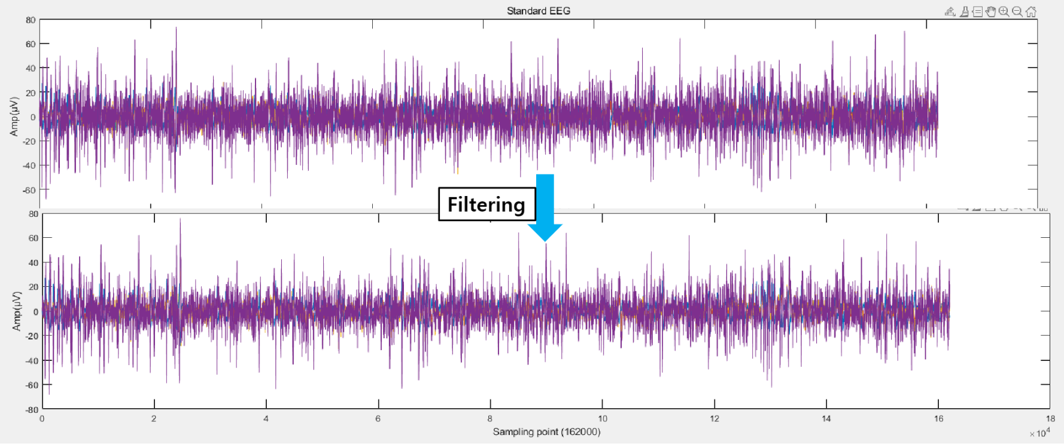
Example of EEG

Slide 8
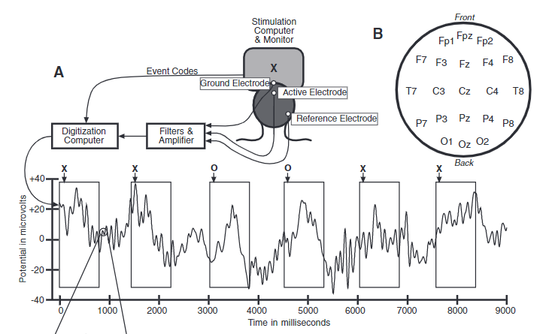
EEG recording

Slide 9
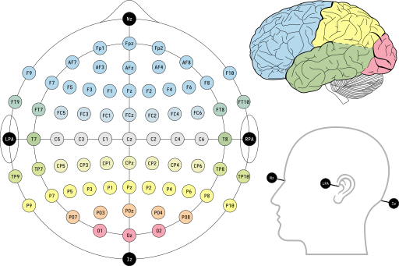
EEG channel (electrode)
F : Frontal
C : Central
P : Parietal
O : Occipital
T : Temporal
A : Anterior
Z : Midline

Slide 10
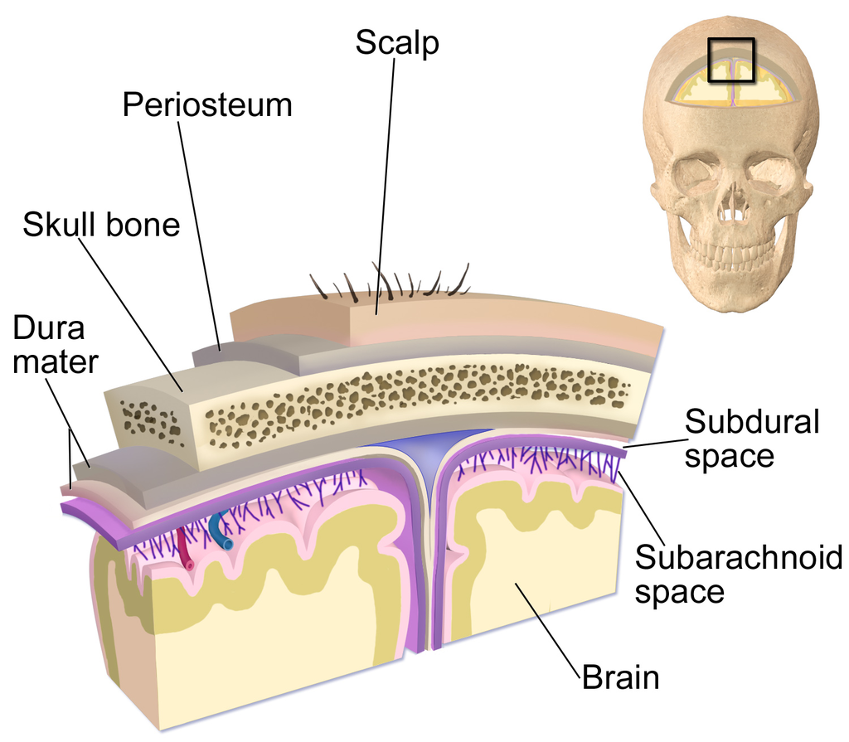
Layers covering the Brain
Electrode

Slide 11
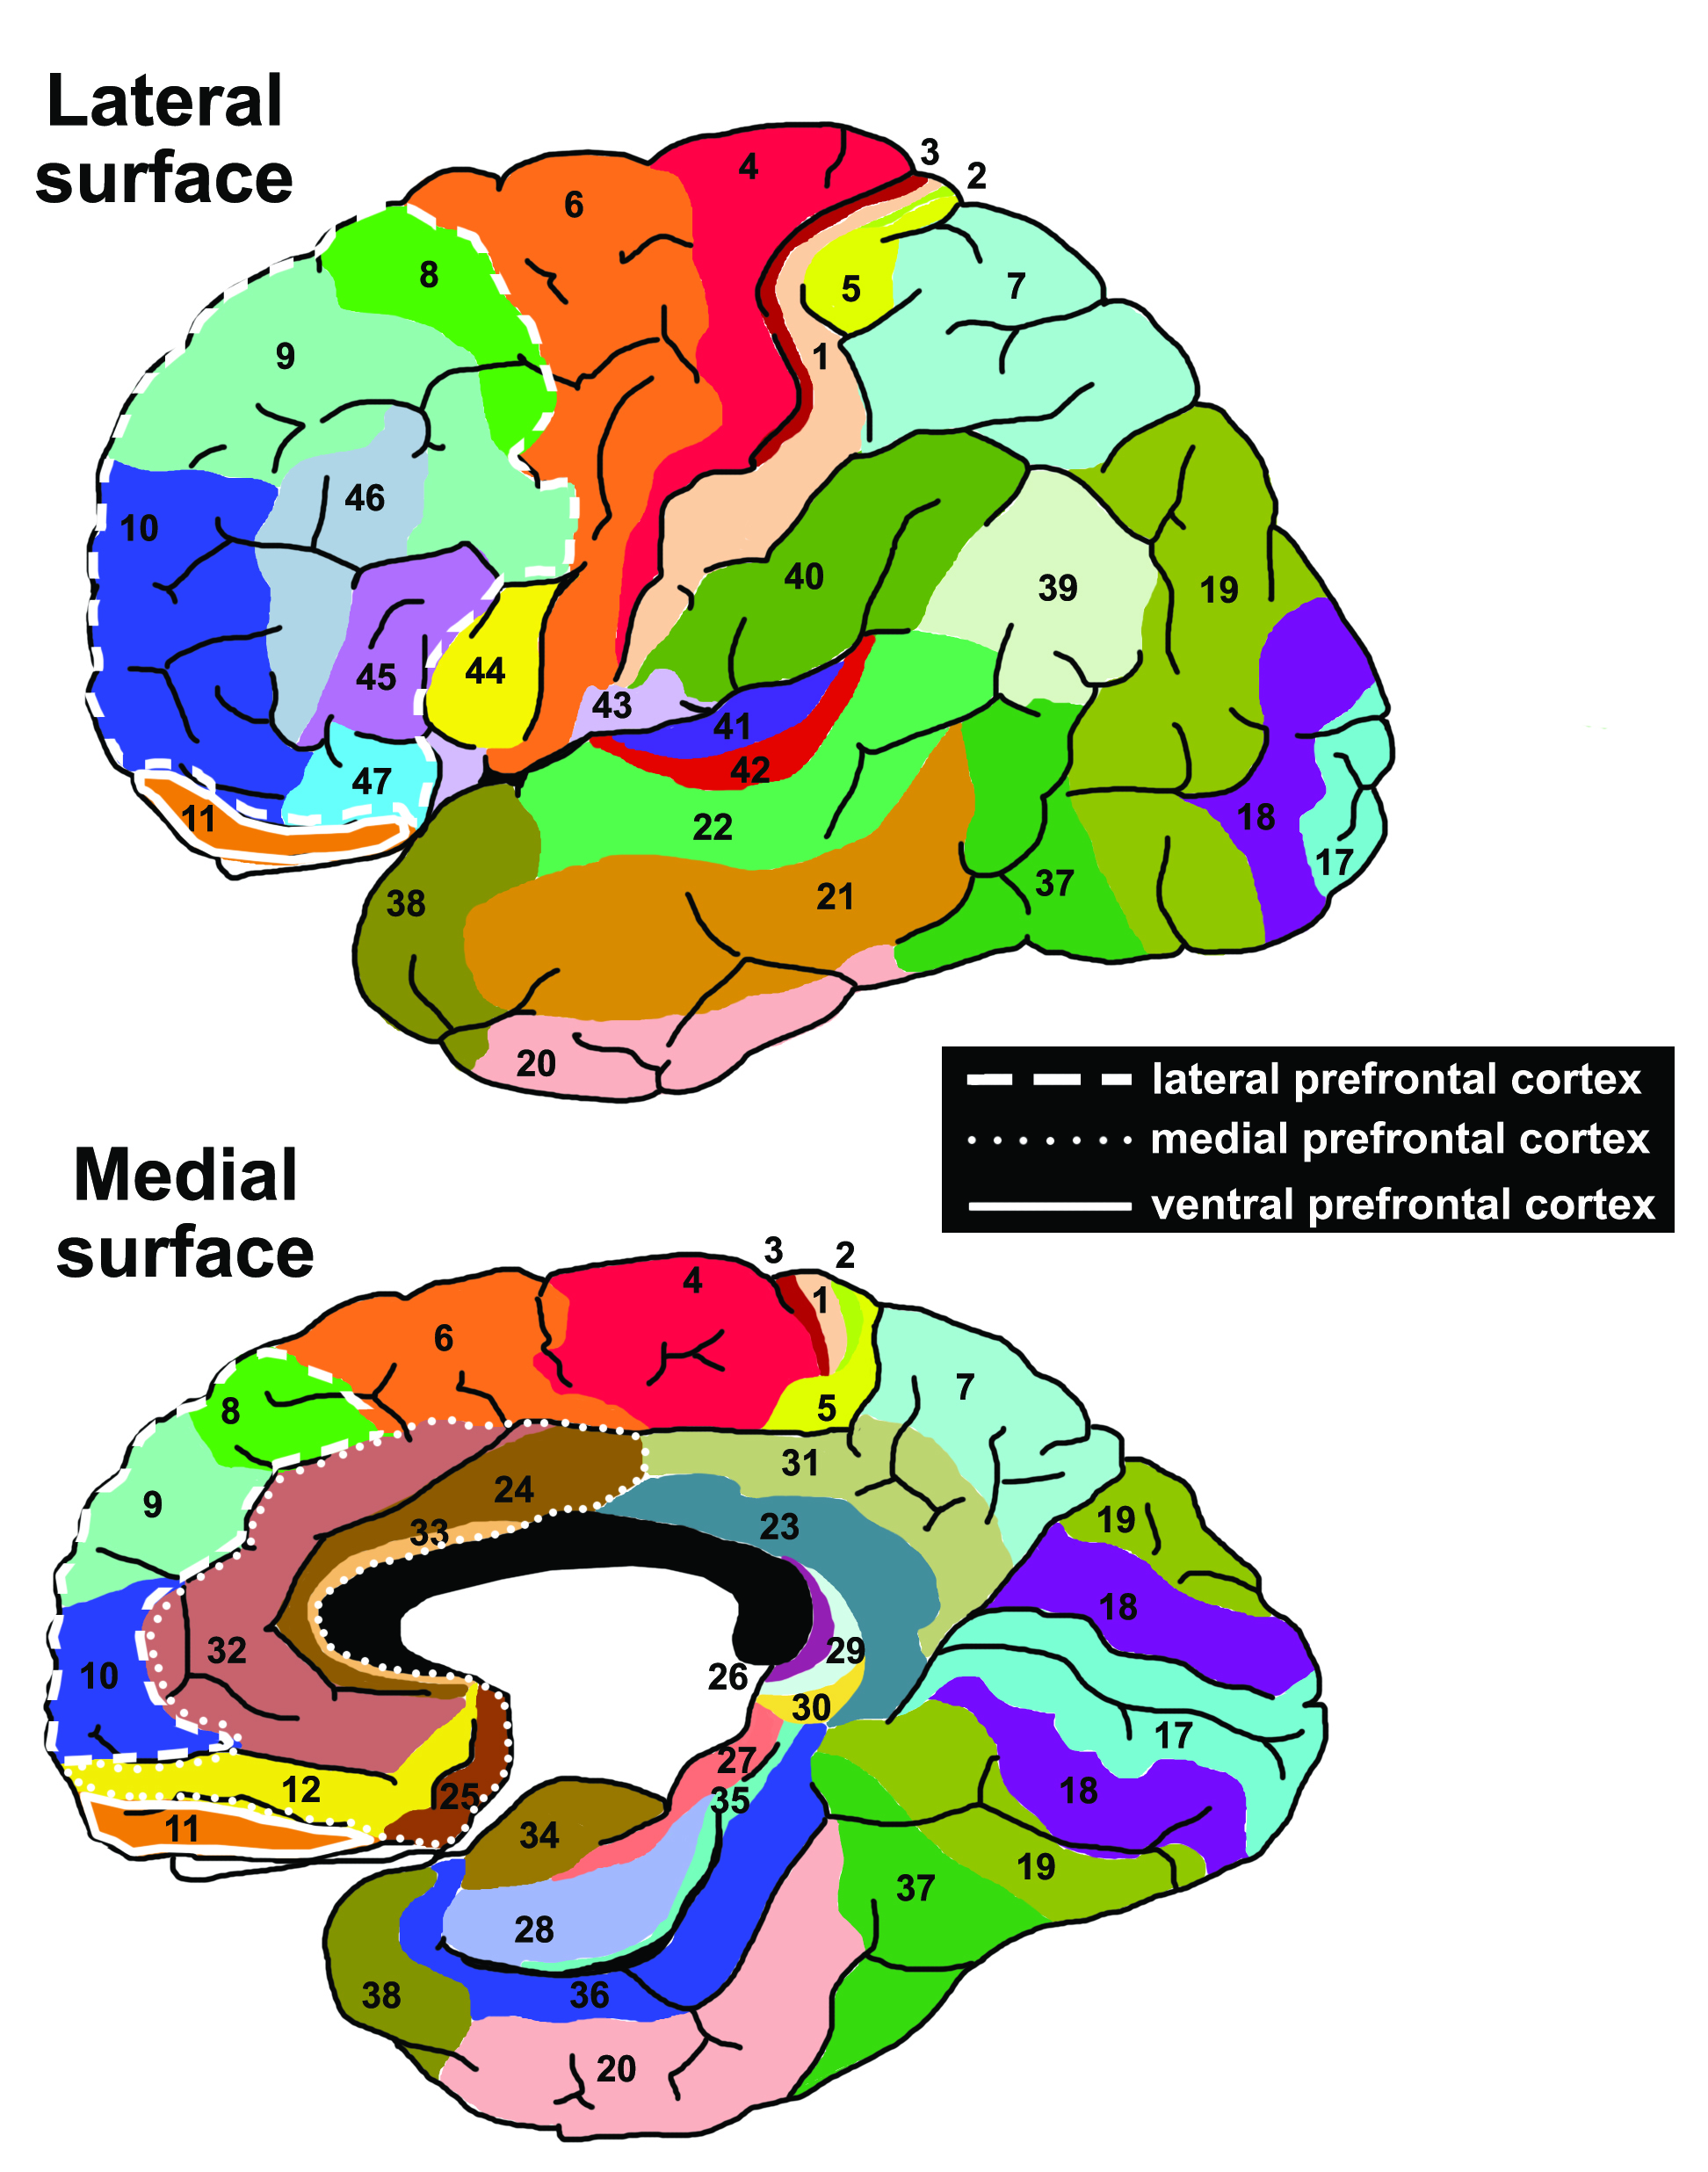
Brodmann Area (Brain Atlas)

